Slide 1
Home
Service
About Us
Contact
MUSICIFY
MUSIC RECOMMENDATION SYSTEM

Slide 2




Home
Service
About Us
Contact
introduction
Recent advancements in recommendation systems , driven by machine learning and big data, leverage vast user databases to provide personalized recommendations without direct user queries.

Slide 3

Home
Service
About Us
Contact
WHY WE NEED ?
Difficulties:
Chооse from millions of songs
To make Queue of songs
The availability of new and trending music
Get better reсоmmended queue
No need to create queue manually

Slide 4


Home
Service
About Us
Contact
OBJECTIVE
To define the requirements for the development of the System.
To predict the appropriate songs based on the characteristics of the music that has been heard previously.
Then offer to user a queue of recommended songs

Slide 5

Home
Service
About Us
Contact
FEATURES
User Registration and Authentication
Search and Browse
Get recommendation
Music Recommendation Engine:
on user preferences.
listening history
trends
Compatible with major web browsers (Chrome, Firefox, Safari) and mobile platforms (iOS, Android)

Slide 6
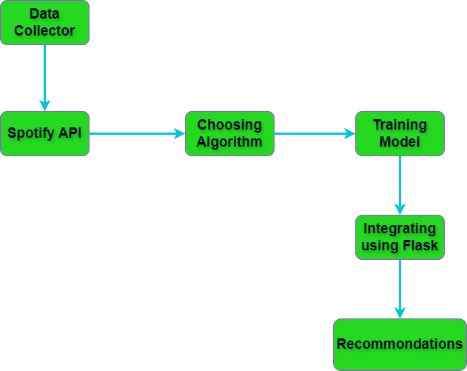
Home
Service
About Us
Contact
Recommendation Flowchart

Slide 7
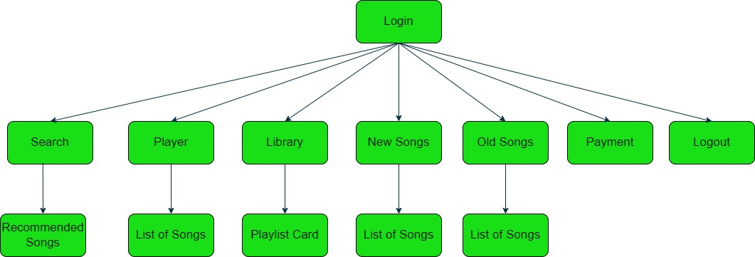
Home
Service
About Us
Contact
Navigation chart

Slide 8
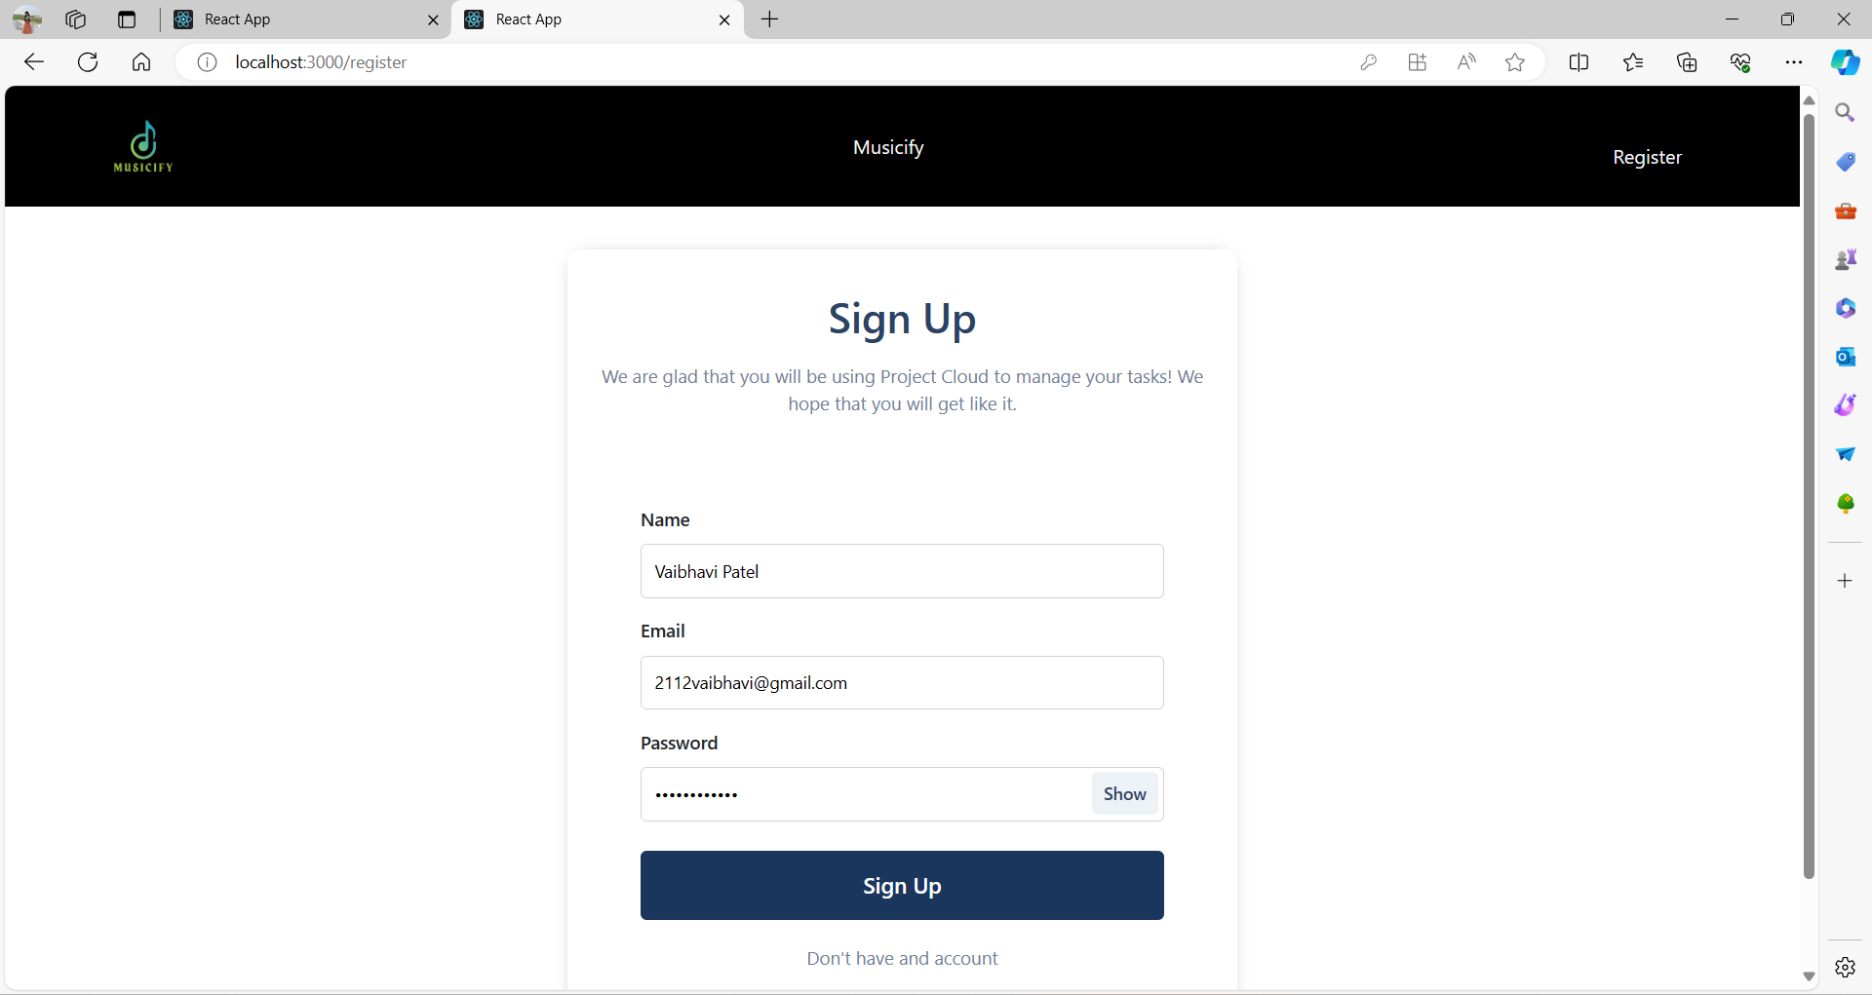
Home
Service
About Us
Contact
Our website
Registration Page

Slide 9
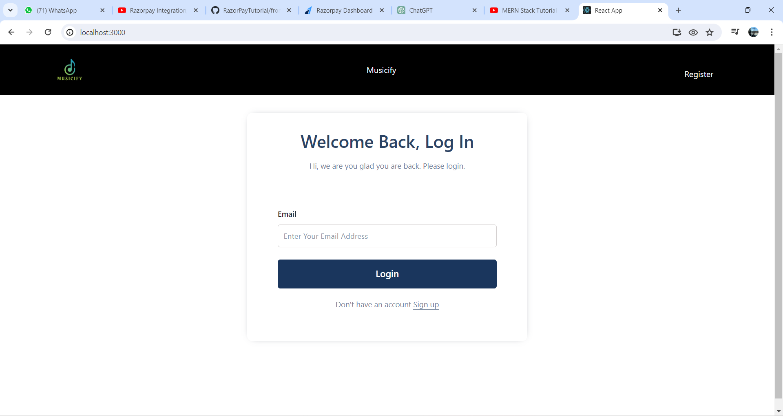
Home
Service
About Us
Contact
Our website
Login Page

Slide 10
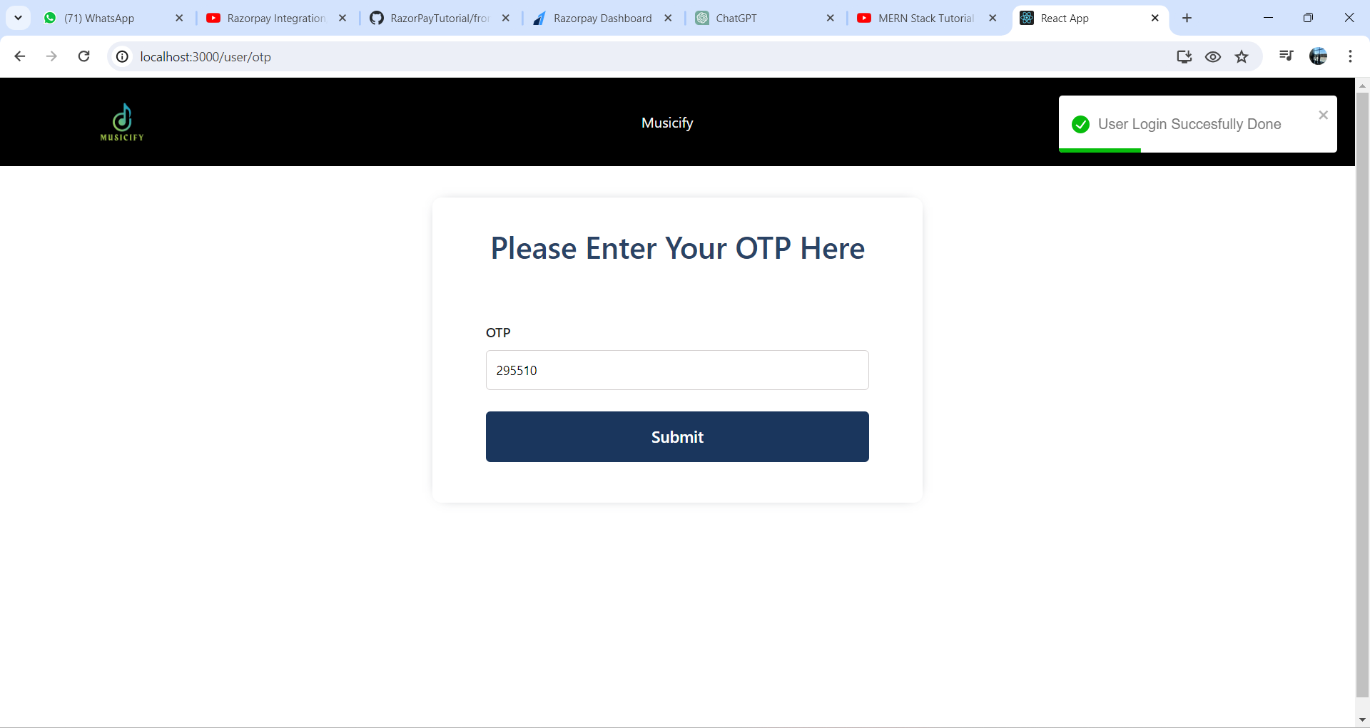
Home
Service
About Us
Contact
Our website
OTP Authentication

Slide 11
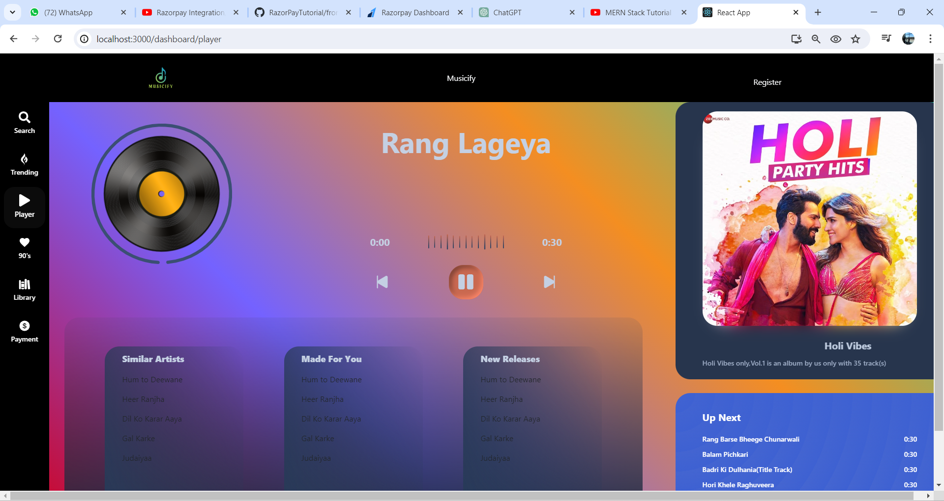
Home
Service
About Us
Contact
Our website
Player Page

Slide 12
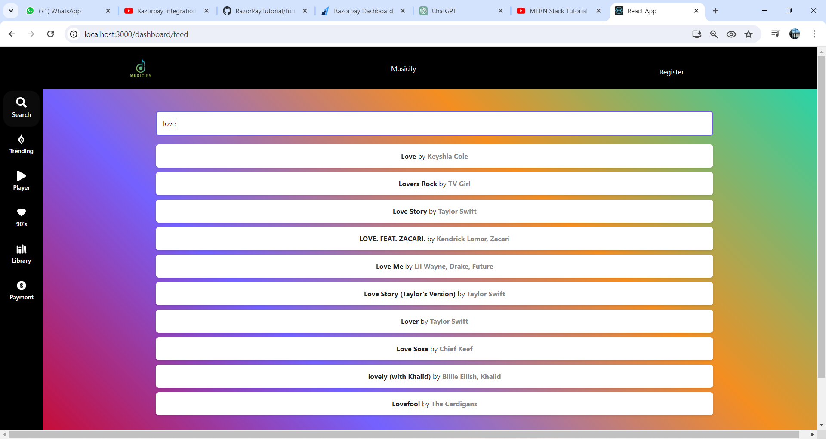
Home
Service
About Us
Contact
Our website
Recommendation Page

Slide 13
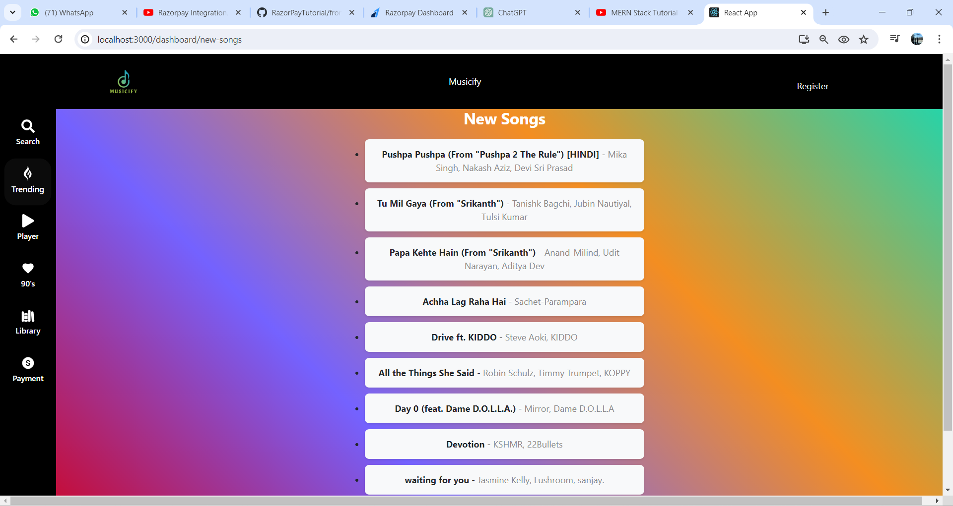
Home
Service
About Us
Contact
Our website
New songs

Slide 14
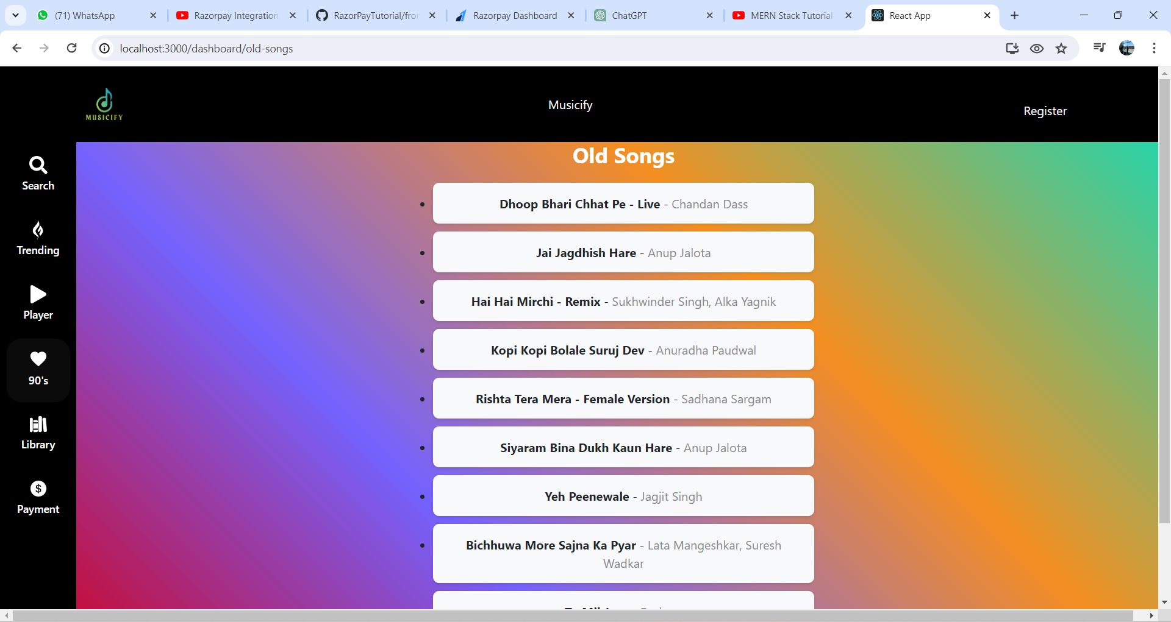
Home
Service
About Us
Contact
Our website
Old songs

Slide 15
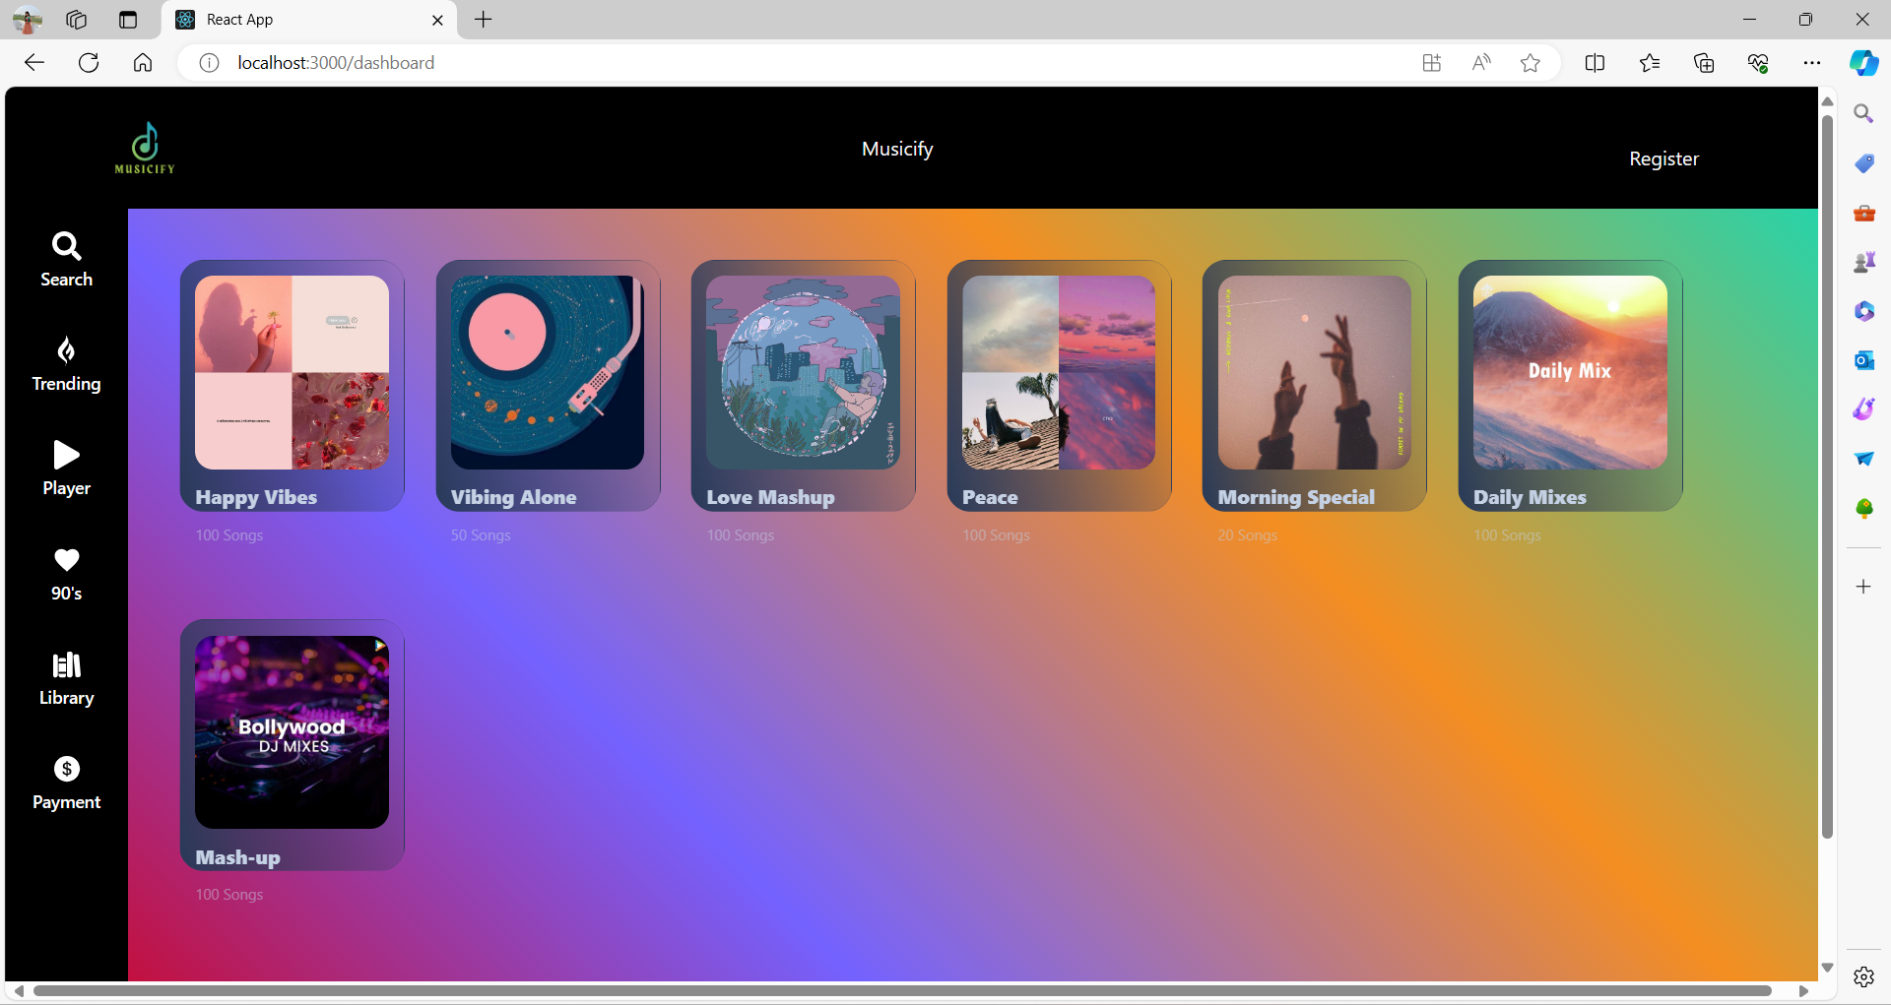
Home
Service
About Us
Contact
Our website
Player Page

Slide 16


Home
Service
About Us
Contact
FRONTEND TOOLS
16

Slide 17





Home
Service
About Us
Contact
BACKEND TOOLS
17

Slide 18

Home
Service
About Us
Contact
OUR VISION
01
will provide users to download the songs offline for Free
02
Users will be able to make their own mashups by mixing up various songs
02
18

Slide 19
Home
Service
About Us
Contact
MEET OUR TEAM
IT103-PANKTI PATEL
IT108-VAIBHAVI PATEL
21ITUOS021
21ITUBS072
19

Slide 20
Home
Service
About Us
Contact
RESOURCES
API : https://developer.spotify.com
: https://www.razorpay.com
MONGO DB : https://www.mongodb.com
Images : https://in.pinterest.com
Content : https://www.wikipedia.org
20

Slide 21

Home
Service
About Us
Contact
THANK YOU!

